Slide 1

Procedural Terrain Generation
Making a world from scratch
Venkatraman Srikanth
Delta Force

Slide 2
What I am going to talk about?
The problem
My bad idea
The better idea

Slide 3
The Big Problem
Given an integer, make a random world ☺

Slide 4
Approaching the Problem
What do we have to do?
Input – Some integer
Output – Some random world/map
=> each world must be unique to the integer given
=> a given input always makes the same world
=> no randomness!

Slide 5
The Answer
Pseudo - Randomness!
Pseudo - Randomness?

Slide 6
Requirement
Given a starting point number (the input integer), generate a lot of random numbers whenever we want

Slide 7
The Real Answer
Let’s just take a number, and screw it up really bad and hope people don’t notice

Slide 8
Screw up a number
Let’s take a number, and multiply something to it
X = A*X

Slide 9
Screw up a number more
Now let’s add something to it
X = A*X + C

Slide 10
Not random enough?
Modulus to the rescue!

Slide 11
Making values not sequential
Let’s modulus by 12.
Let’s start at 1, and increment by 7.

Slide 12
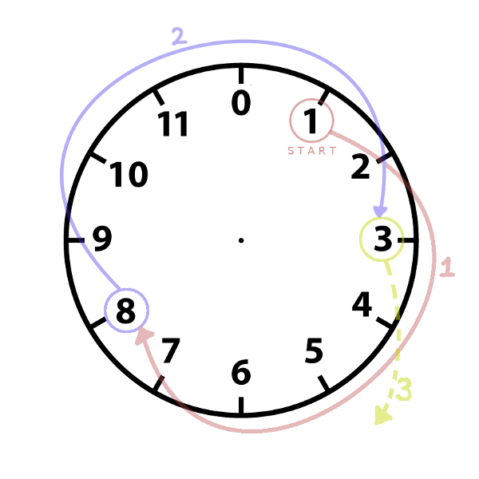
Making values not sequential
Series :
1
8
3
10
5
0
7
2
9
4
11
Random enough!

Slide 13
The LCG!
Linear Congruential Generator

Slide 14
For large values
A = 1103515245
C = 12345
M = 2³¹ = 2147483648
This is what C’s rand() uses!

Slide 15
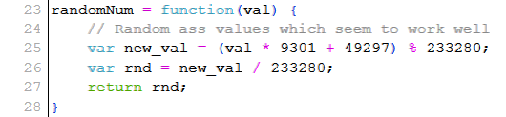
A memorable snippet

Slide 16

The second problem – the world
Let’s start with some water.
A big 2D grid of water.
Water is nice.

Slide 17

The second problem – the world
Let’s put some points of land

Slide 18
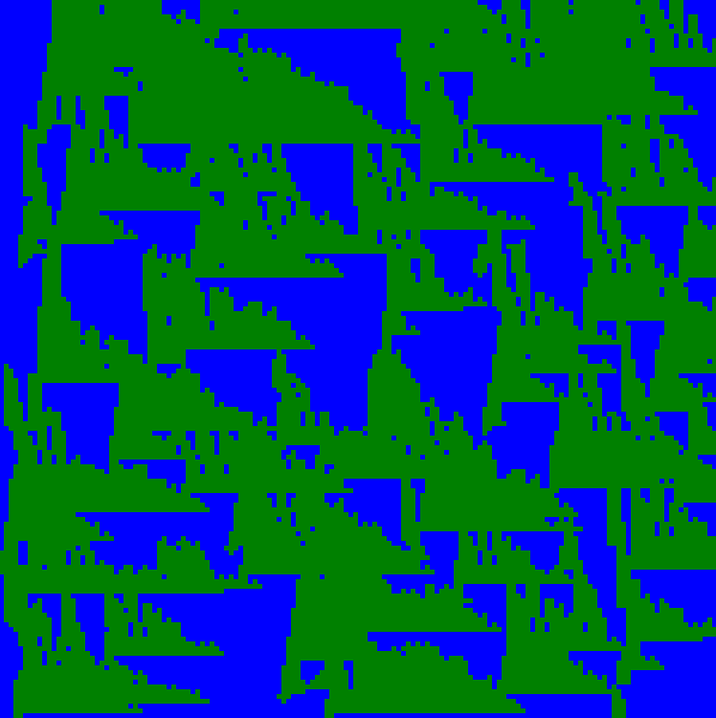
The second problem – the world
Lo! We have land!

Slide 19
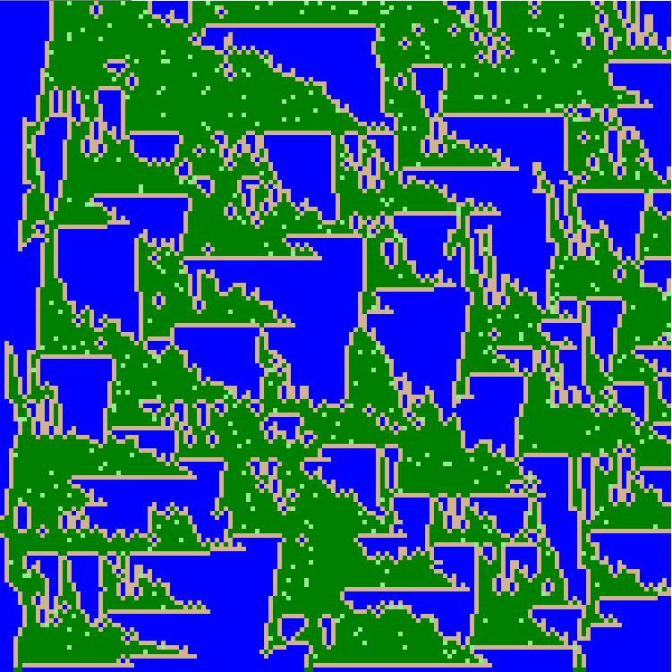
Bad idea, bad execution, but it’s something

Slide 20
How to improve?
Let’s look at a real world application

Slide 21
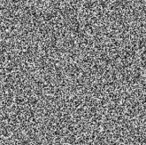
What does this look like?

Slide 22
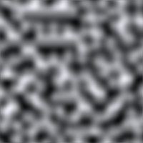
What does this look like?

Slide 23
Behold, Perlin Noise!

Slide 24
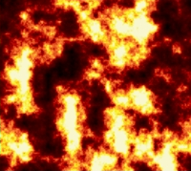
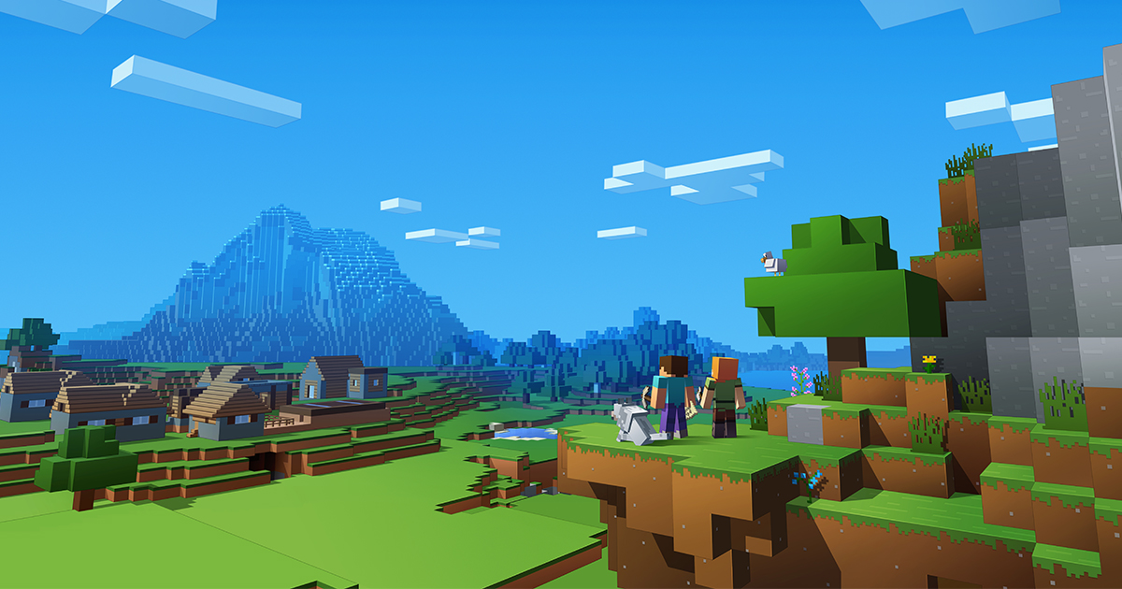
Some Applications

Slide 25
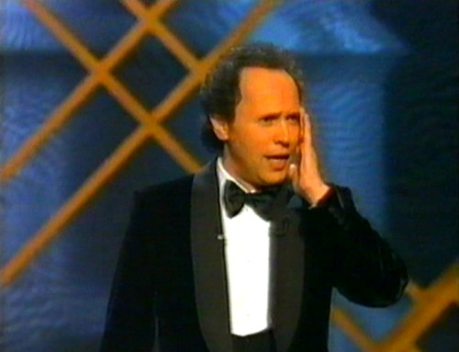
Ken Perlin, The Oscars, 1996

Slide 26
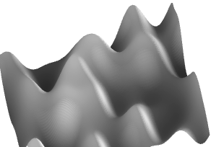
But how do we make terrain?
A Heightmap!

Slide 27
Sweet! How does it work?
Gradients!

Slide 28
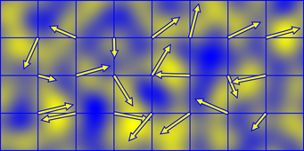
A schematic

Slide 29
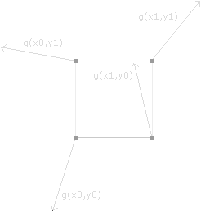
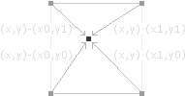
Computing the Gradient Product

Slide 30
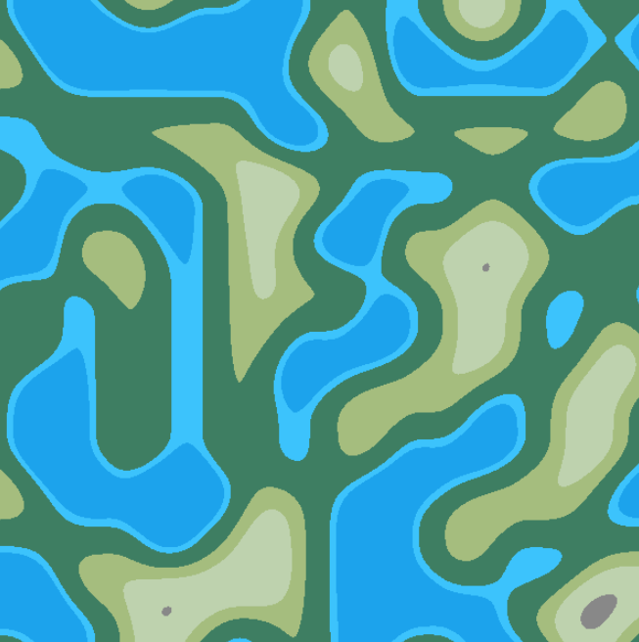
Let’s make better terrain!

Slide 31
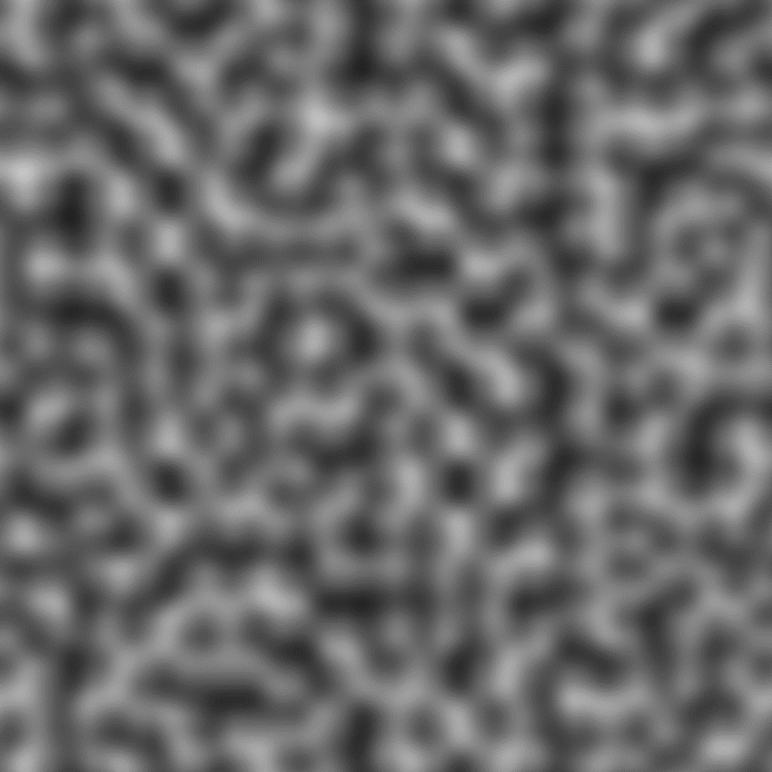

Something is missing - detail!

Slide 32
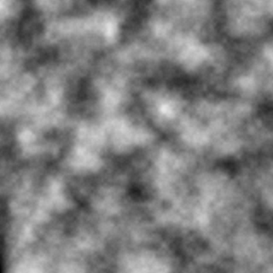
Let’s put them together!

Slide 33
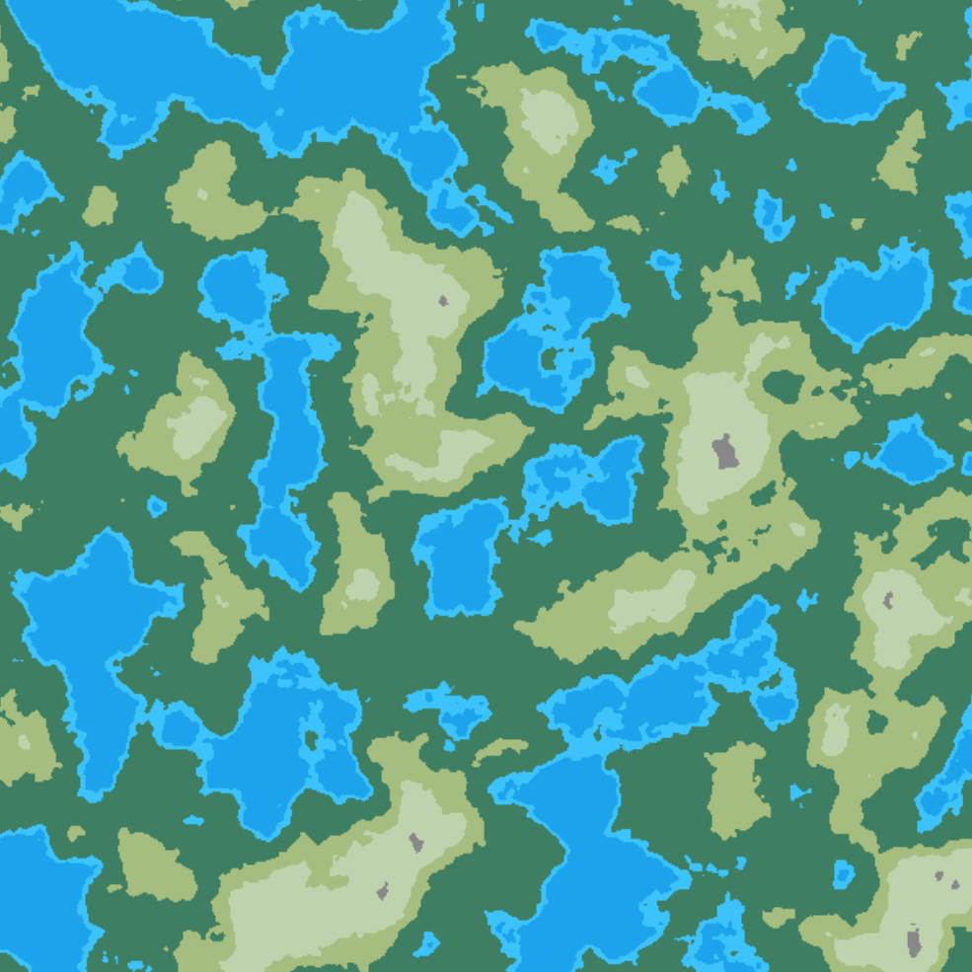
Let’s put them together!

Slide 34
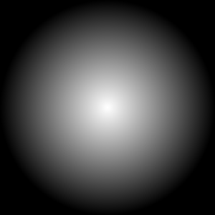
Making it an island - Weight the centre

Slide 35
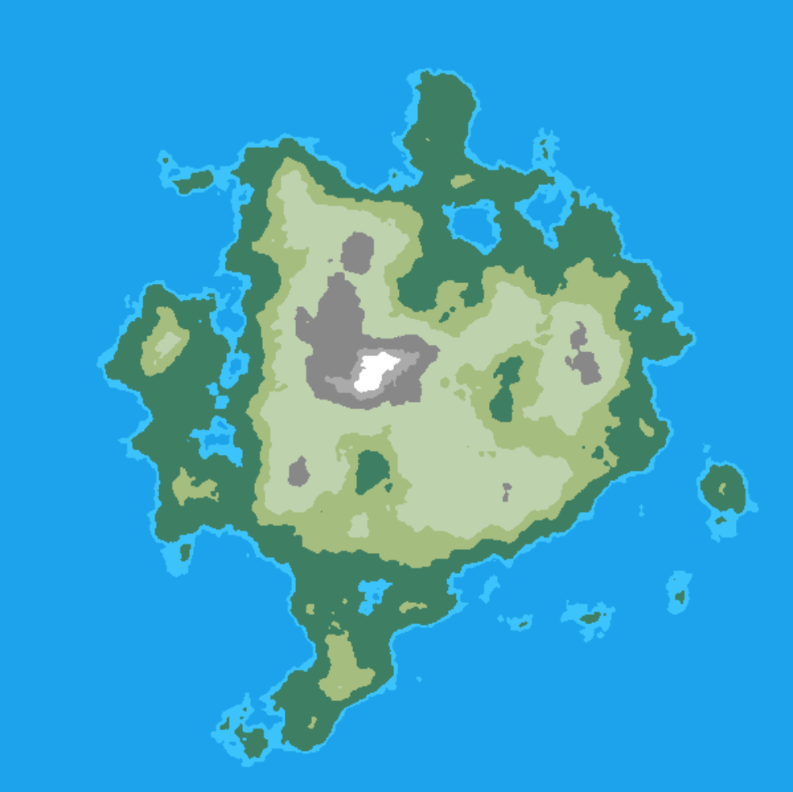
The End Result :

Slide 36
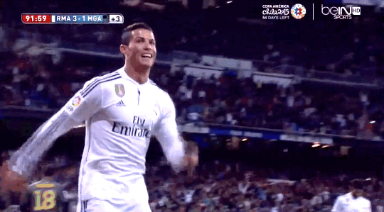
We did it!

Slide 37
View all the demos and the source code
venkatraman.me/proc-map-gen
Thanks for being a wonderful audience!

